Slide 1
Microsoft Identity & Network Access EMEA Virtual Onsite Enterprise Track

Slide 2
Microsoft identity platform Overview
Pratik Gautam
Microsoft Confidential. Shared under NDA.

Slide 3



Speaker Bio
Pratik Gautam
Product Manager, Microsoft
IDNA CxP Developer Care
@prgaut

Slide 4
Inclusive Session Guidelines
Please practice these tips while in the Virtual Onsite sessions.
Voice Guidance
Raise virtual hand so the moderator can call on you
State your name when speaking
Return to mute when not talking
Chat Guidance
Q: to preface questions
@mention to respond to an individual
Stay on topic
Use alt-text for images and gifs
Allyship
Seek to understand, not drive agreement
Focus on ideas, not people
Support and amplify peers
Avoid acronyms
Microsoft Confidential. Shared under NDA.

Slide 5
Let’s start with some code
Microsoft Confidential. Shared under NDA.

Slide 6
What Microsoft identity platform does for developers
Developers delegate Identity and Access Management to Microsoft Identity
Authenticates users
UserID and password, MFA, Passwordless
Authorizes applications to access resources
Robust directory data with Microsoft Graph
Access to the data that drives productivity across Microsoft 365
For ISVs
Provision users to the app
Verifies app publishers
Notes:
This slide explains what an Identity platform provides to an application. This primary is proving tokens to apps to accomplish 2 tasks. Authenticate the user to the app and authorize the app to call an API (resource).
Outside if these 2 core tasks, an Identity platform provides:
directory data to the app, ours enables the app to build on all of Microsoft 365 as well.
The ability to inform the app of Movers/leavers/joiners through provisioning
The ability for developers to have their identity verified so speed adoption of the app

Slide 7

Microsoft Zero Trust architecture
Classify, label, encrypt
Data
Identities
Organization policy
Multi-factor authentication
Adaptive access
Apps
User/session risk
Security policy enforcement
Real-time policy evaluation
Device risk state
Access and runtime control
Infrastructure
Device inventory
Devices/ Endpoints
Threat protection
Threat intelligence
Visibility and Analytics
Network
Automation

Slide 8
Microsoft’s Zero Trust enabling technologies
Classify, label, encrypt
Azure Active Directory/
Data
Intersectional policy assessment (context, risk)
Identities
User requests access to resource
Microsoft Information Protection
Microsoft Defender for Identity
Resource directs to AAD for auth
Route through CASB
Apps
Azure AD Conditional Access
Policy enforcement
Apply controls and assess for anomalies
Microsoft Defender for Cloud Apps
Microsoft Defender for Endpoint
Infrastructure
Devices/ Endpoints
App and/or device health and security verified
Network security verified
Intersectional risk assessment (threat intel, familiarity)
Azure Security
Microsoft Endpoint Manager
Intelligent and automation
Network
Azure Sentinel and Microsoft Defender XDR
Azure Networking

Slide 9
Microsoft’s Zero Trust enabling technologies
Classify, label, encrypt
Azure Active Directory/
Data
Intersectional policy assessment (context, risk)
Identities
User requests access to resource
Microsoft Information Protection
Microsoft Defender for Identity
Resource directs to AAD for auth
Route through CASB
Apps
Azure AD Conditional Access
Policy enforcement
Apply controls and assess for anomalies
Microsoft Defender for Cloud Apps
Microsoft Defender for Endpoint
Infrastructure
Devices/ Endpoints
App and/or device health and security verified
Network security verified
Intersectional risk assessment (threat intel, familiarity)
Azure Security
Microsoft Endpoint Manager
Intelligent and automation
Network
Azure Sentinel and Microsoft Defender XDR
Azure Networking
Notes:
3 Key elements that apps need to build on Microsoft identity platform to enable Microsoft Zero Trust
Azure AD Conditional Access – no additional work required above building on Microsoft identity platform
Resources are protected with Azure AD – Protect your APIs with Azure AD. See protecting APIs session. This is needed so that Azure AD can apply Conditional Access to your resources
Device health and security – Use auth brokers for public clients whenever possible.

Slide 10








Microsoft identity platform for developers
Build applications and integrate identity with one unified toolkit
OIDC Certified Endpoints
Microsoft Authentication Libraries (MSAL)
For clients and services
Endpoints
Libraries
Web API
Including Microsoft Graph, Azure, and your own APIs
Available via Microsoft Authentication Libraries
Web API
Auth Brokers
Work and school accounts
Azure AD
Personal accounts
MSA
Customer and Partner accounts
Supported identities
Azure AD External Identities (includes Azure AD B2C)
Industry standards

Slide 11
Cloud Identity Provider

Slide 12
Cloud Identity Provider
Available to any app anywhere
Access to https://login.microsoftonline.com required

Slide 13



Cloud Identity Provider
Available to any app anywhere
Access to https://login.microsoftonline.com required
Supports Standards
WS-Federation

Slide 14
Protocols do not guarantee security, Developers do
Modern protocols have flaws and limitations:
Token replay to client (implicit Grant) – Nonce, recommended only in limited scenarios
Token replay to server – Timestamps, session IDs
Token caching
Token lifetimes
Lack of access to health and security details of the device
Microsoft Libraries (MSAL) best choice when using Microsoft identity platform. Use MSAL as a first choice
If MSAL is not available for your platform: make sure your developers are using a well-maintained library
If you do choose to implement the protocol, be aware of the large investment required to properly implement the protocol and the recommendations and to limitations of capabilities.

Slide 15
Microsoft Authentication Libraries (MSAL)
MSAL for Android | Android
MSAL Angular | Single-page apps with Angular and Angular.js frameworks
MSAL for iOS and macOS | iOS and macOS
MSAL Go (Preview) | Windows, macOS, Linux
MSAL Java | Windows, macOS, Linux
MSAL.js | JavaScript/TypeScript frameworks such as Vue.js, Ember.js, or Durandal.js
MSAL.NET | .NET Framework, .NET Core, Xamarin Android, Xamarin iOS, Universal Windows Platform
MSAL Node | Web apps with Express, desktop apps with Electron, Cross-platform console apps
MSAL Python | Windows, macOS, Linux
MSAL React | Single-page apps with React and React-based libraries (Next.js, Gatsby.js)
Learn about MSAL - Microsoft identity platform | Microsoft Docs

Slide 16
Fast and simple integration Authentication libraries
Secure access to users and data made simple
Microsoft’s (Microsoft Graph, other APIs)
Your own APIs
MSAL - best in class auth libs
Reach any audience
Follows Microsoft Security Development Lifecycle
Goes beyond being a protocol library
Handles the protocol details without requiring code by developer. For example, the mechanics of token refresh
Microsoft Continuous Access Evaluation and Proactive token refresh (details later)
Enables app to use Auth Brokers (details later)

Slide 17
What is automatic user provisioning?
Allows IT admins to automate the creation, maintenance and removal of user identities in one or more target identity stores.
These actions are based on changes to users/groups in Azure AD or HR profiles.
Also called “Joiner-Mover-Leaver” scenarios
HR Data
User Profile Data
Legal Name
Preferred Name
User ID
Custom Attribute(s)
Job Data
Worker Type
Employee ID
Position Info
Business Title
Work Address
Manager
Company/Division/Department
Dates
Hire Date
First Day of Work
Effective Dates
Last Day of Work
AD, Azure AD and SaaS apps

Slide 18
What is SCIM?
SCIM is an emerging standardized protocol and schema for managing users and groups. More info: http://www.simplecloud.info/
Experienced growth of adoption in 2015-2016 among popular SaaS apps like Workplace by Facebook, Slack, and Github
Many of our pre-integrated connectors in the app gallery happen to use SCIM
We also have a generic connector for non-gallery and custom apps that implement SCIM 2.0. More info: http://aka.ms/SCIM

Slide 19
What we hear from customers
Increased visibility and control
More proactive decisions, easier reactive ones
Systems should keep data safe and reduce decision burden
Accelerated app adoption for trustworthy developers

Slide 20
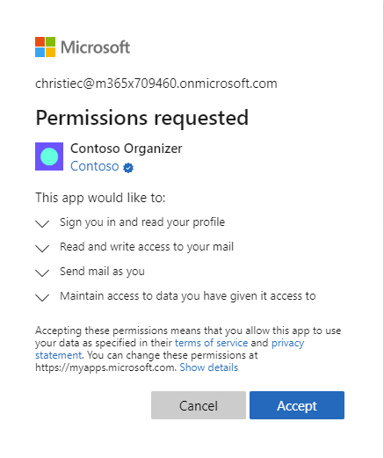

Slide 21
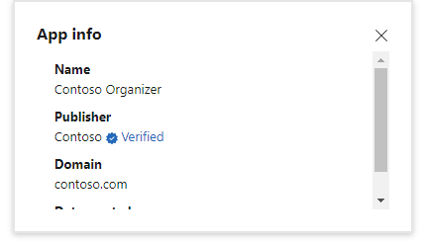

Slide 22
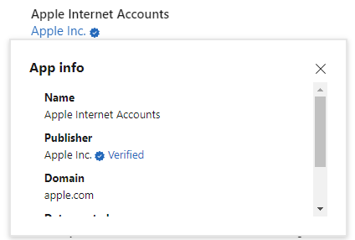

Slide 23
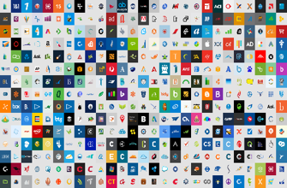












Azure AD for partners and customers
CONNECT WITH CUSTOMERS
COLLABORATE WITH PARTNERS
contoso
Social IDs
Business & Government IDs
On-premises & web apps

Slide 24

Let’s start with an app
Decisions:
Trust Microsoft identity platform
How will customers trust your app
Work for the user or as the app itself
What resources are required and when
When to ask for permission to a resource

Slide 25
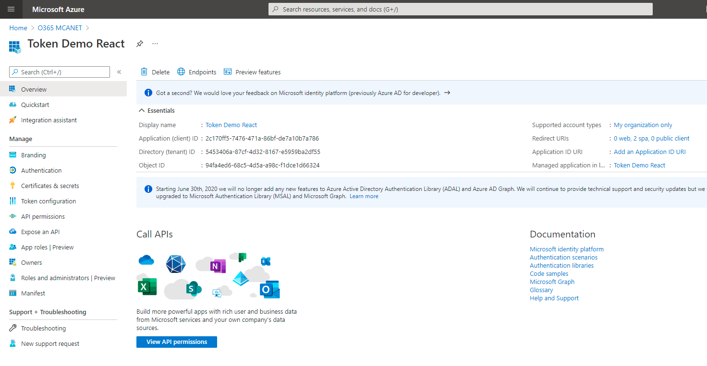
App Registration: App Trusts Microsoft identity platform
What Azure AD considers “the app”
Information about the app:
Name, logo, and publisher
Reply URLs, Secrets, …
One App Registration per App
“Application Object”

Slide 26
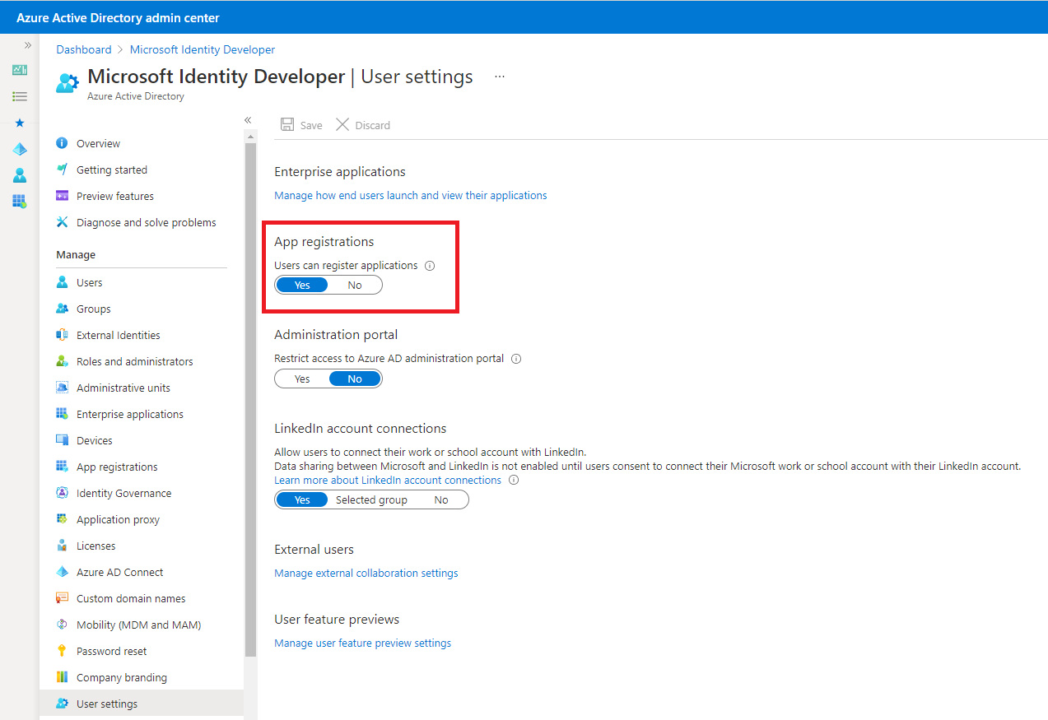
App Registration: Who can register an app
Admins decide who can register apps in their tenant

Slide 27
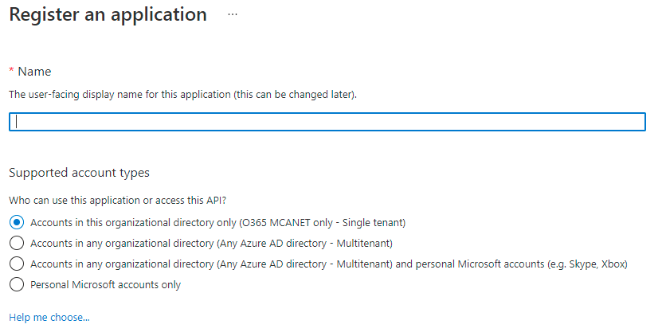
App Registration: Support account types?
Second required question when registering an app.

Slide 28
“Accounts in this organizational directory only”
Only allows users from the tenant where the app is registered
Single-tenant
App
Adatum tenant

Slide 29

Registering the app is not enough
Need:
User and group application and role assignments
Permissions granted to the application
Policies including conditional access policy
Alternate local settings for an application
Visible in Enterprise Applications
Service Principal
SP
App
Adatum tenant

Slide 30
“Accounts in any organizational directory”
Allows users from any tenant
Multitenant
Can optionally include Microsoft personal accounts (Outlook.com, …)
Registered in its “Home” directory (same process as single-tenant)
Admins decide who can consent to apps in their tenant
SP
App
Adatum tenant

Slide 31
“Accounts in any organizational directory”
Allows users from any tenant
Multitenant
Can optionally include Microsoft personal accounts (Outlook.com, …)
Registered in its “Home” directory (same process as single-tenant)
Admins decide who can consent to apps in their tenant
SP
SP
App
Adatum tenant
Contoso tenant

Slide 32
Multitenant App vs External Identities (aka B2B)
Adatum
Contoso
Adatum App Registration
Adatum Data
Contoso Data
User A
User B
User B
Multitenant app
Uses common endpoint to sign in
No invitation/external account needed

Slide 33
Multitenant App vs External Identities (aka B2B)
Adatum
Contoso
App Registration
Adatum Data
User A
User B
User B
External Identities
Use Adatum endpoint to sign in
Can’t use common endpoint
Invitation/external account needed

Slide 34
Demo Application registration
Pratik Gautam
Microsoft Confidential. Shared under NDA.

Slide 35
Microsoft identity platform
Standards based cloud endpoint
User Authentication
App Authorization
Microsoft Authentication Library family
Microsoft Graph
Provision Users to apps
Verified app publishers
Control Plane for today’s apps

Slide 36
Thank You
Microsoft Confidential. Shared under NDA.

